Slide 1
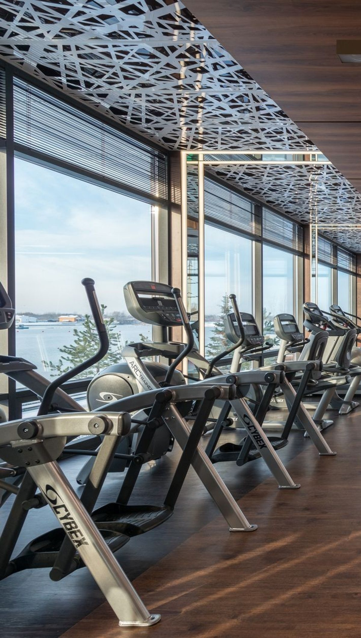

ADVERTISER PACK
2026 / 27
Reach the people
who buy.
For the people who own and run gyms, studios and personal training businesses.
GYMBUSINESSNEWS.COM
COGENT MULTIMEDIA LTD

Slide 2
WHO YOU REACH
The people you’re getting in front of.
THE LIST TODAY
21,820
named fitness business owners and managers subscribed to the newsletter.
Gym Business News goes to owners and managers of independent gyms and studios, self-employed personal trainers and fitness franchisees.
28,328
average monthly visits to the Gym Business News website.
WHAT THEY BUY
Gym equipment and strength kit
53.0%
average open rate against an industry average of 20%.
Membership, booking and payments software
Flooring, fit-out and facilities
Insurance, accountancy and finance
Supplements and retail stock
Marketing, training and recruitment
7.42%
average click rate against an industry average of 2%.
GYM BUSINESS NEWS · WHO YOU REACH
2 / 7
Notes:
Subscribers: Mailchimp, subscribed members on 20 Oct 2026. Open and click rates: pooled across all 7 issues sent to this list. Visits: GA4 sessions, 2026-09-20 to 2026-10-19.

Slide 3
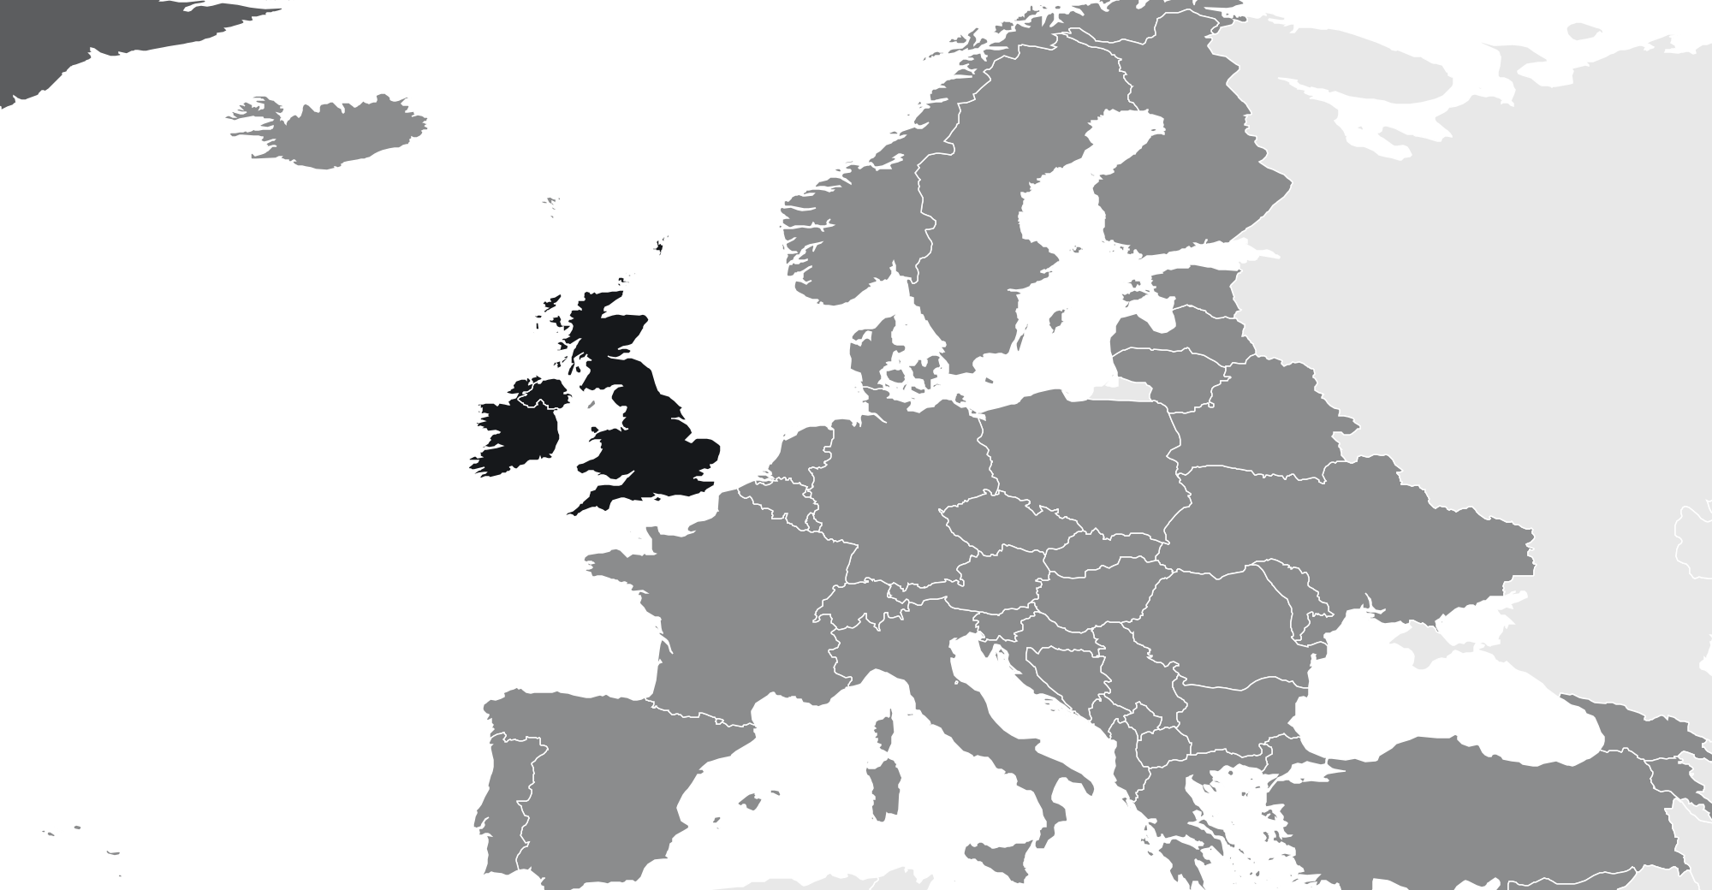
WHO READS
Who reads Gym Business News
76% own, direct or manage a gym or studio.
38%
8.0%
30%
24%
WHERE THEY ARE
Owner or founder
Director
Gym or fitness manager
Personal trainers and instructors
MOST COMMON ROLES
Gym or studio owner
32%
PT running own business
20%
Gym manager
18%
Fitness manager
8.0%
Franchisee
6.0%
Area or operations manager
5.0%
75%
10%
8.0%
4.0%
3.0%
UK and Ireland
North America
Europe
Australia and NZ
Rest of world
BUSINESS TYPE
TURNOVER
SITES
Independent gym
34%
Under £100k
34%
One
70%
Boutique or class studio
24%
£100k to £500k
38%
2 to 4
22%
Self-employed PT
22%
£500k to £1m
16%
5 or more
8.0%
Franchise
12%
Over £1m
12%
Chain site
8.0%
GYM BUSINESS NEWS · WHO READS
3 / 7

Slide 4
WHAT YOU CAN BUY
Four ways in.
Every format is digital. Our subscribers have requested to receive content from brands who are able to help their business.
Website banners
Sponsored newsletter content
970×250
300×250
Your brand across the whole site.
Sponsored
Your story in our Monday Briefing, next to our editorial and labelled as sponsored.
HOW A BOOKING RUNS
728×90
01
You tell us what channels you want to use.
970×250 · 728×90 · 300×250
400 words · logo · one link
02
We confirm format, date and price in writing.
03
You send artwork, or copy and we build it.
Newsletter sponsorship
Solus email
04
You approve it before anything goes out.
Sponsor
05
We send the report on your campaign alone.
Your brand as the named sponsor of every issue of our Monday Briefing.
Your email
Your own email, sent to our subscribers. Nobody else in it.
Banner
Per issue, or sponsor a series
We build it, or send finished HTML
GYM BUSINESS NEWS · WHAT YOU CAN BUY
4 / 7

Slide 5
RATES
Build a campaign.
FORMAT
ONE
THREE
SIX
EMAIL
Our team of marketing experts can work with you to build bespoke campaigns to fit your advertising goals and strategies.
All marketing options are built to send our audience straight to your website with one easy click.
Whatever you chose, it’s designed to deliver traffic to you.
Eshot
£1,000
£750
£500
Your message alone, nobody else in it
EACH
EACH
Newsletter sponsorship
£800
£600
£400
Named sponsor of the Monday Briefing
EACH
EACH
CONTENT
Sponsored article
£200
£150
£100
On the website and in the newsletter
EACH
EACH
DISPLAY
ONE MONTH
THREE MONTH
SIX MONTH
Homescreen Pop-Up
£1,200
£2,700
£3,600
Pops up after 6 seconds
TOTAL
TOTAL
Billboard, 970×250
£900
£2,100
£3,000
TALK IT THROUGH
Top of the homepage
TOTAL
TOTAL
jb@gymbusinessnews.com
Leaderboard, 728×90
£600
£1,200
£1,800
Across the site
TOTAL
TOTAL
MPU, 300×250
£400
£800
£1,200
Sidebar button
TOTAL
TOTAL
All rates exclude VAT
GYM BUSINESS NEWS · RATES
5 / 7

Slide 6
WHAT RESULTS YOU GET
The numbers
you get back.
Statistics
All numbers are an average
EMAIL CAMPAIGN
Delivered
Inboxes it actually reached
21,820
Within 7 days of your campaign finishing, you’ll receive a full performance report showing impressions, open rate and click-throughs to your website.
Unique opens
People who opened, counted once
53.0%
Unique clicks
People who clicked, counted once
7.4%
Click to open
Of those who opened, who then clicked
13.9%
Unsubscribes
Off the list after your send
0.06%
ON THE SITE
Monthly Total Visits
Total impressions on your content
28,328
WHEN YOU GET A REPORT
Monthly Unique Visitors
Unique users who saw your content
16,184
Within 7 working days of the send.
GYM BUSINESS NEWS · WHAT RESULTS YOU GET
6 / 7
Notes:
Delivered is the current list size. Rates pooled across 7 issues. Visits and unique visitors: GA4 sessions and total users, 2026-09-20 to 2026-10-19.

Slide 7
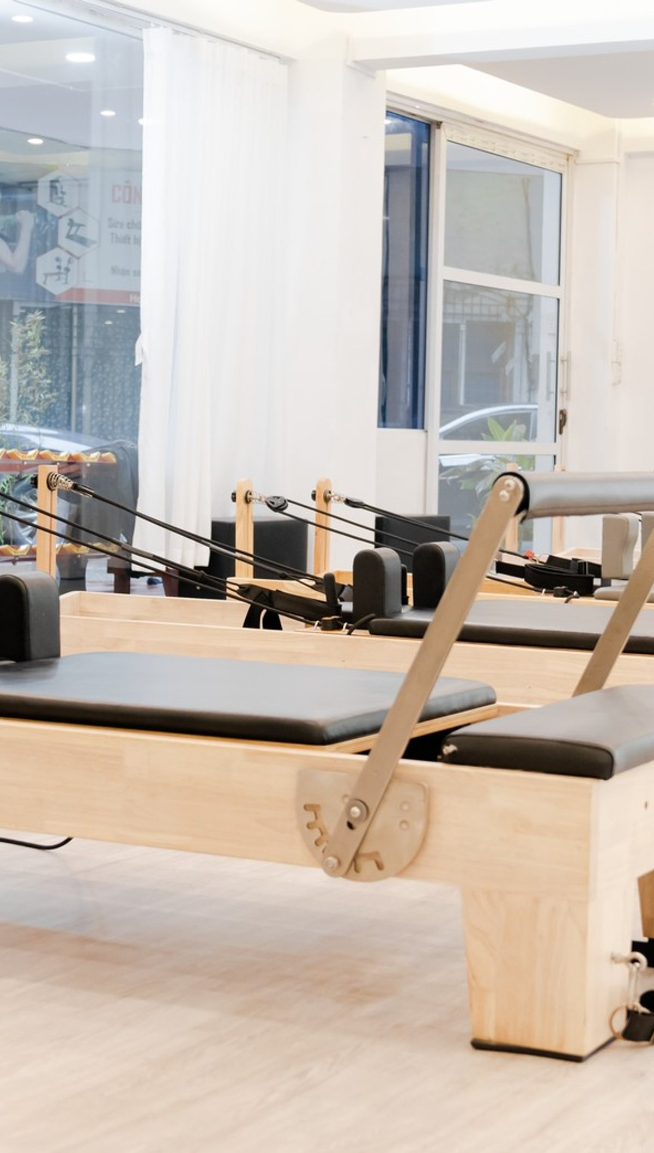
ADVERTISE WITH US
Get in touch.
Tell us who you are trying to reach and what you want it to do, and we will come back with a plan, availability and a price.
ADVERTISING
jb@gymbusinessnews.com
SEND US A STORY
gymbusinessnews.com/submit-news
SUBSCRIBE FREE
gymbusinessnews.com/newsletter
PUBLISHED BY · COGENT MULTIMEDIA LTD, 5 JUBILEE WAY, FAVERSHAM, KENT

